Slide 1
CAPSTONE PROJECT
HOTEL BOOKING ANALYSIS

Slide 2
INTRODUCTION
Welcome to a Journey Through Hotel Booking Analysis!
In the bustling world of hospitality, understanding guest behavior is akin to unlocking the secret to superior service. Our exploration today delves deep into the realms of data-driven insights, revealing the intricate patterns that shape the hotel industry. At its core, Hotel Booking Analysis is a strategic compass guiding hotels toward enhanced operational efficiency, revenue maximization, and unparalleled guest satisfaction.
Why It Matters: By deciphering the nuances of guest preferences, seasonal trends, and booking habits, hotels can craft tailor-made experiences. This analysis forms the bedrock for anticipating guest needs, optimizing revenue streams, and ensuring every stay is memorable.
Our Quest: Join us as we embark on a quest to decipher the guest narrative. From unveiling booking trends over time and exploring the impact of preferences on revenue, to understanding the intricacies of cancellations and crafting strategies for an exceptional guest experience—our journey promises valuable insights and actionable strategies.
Buckle up; we're about to transform raw data into extraordinary guest experiences!

Slide 3
OBJECTIVE
Illuminate Guest Preferences:
Discover what guests truly desire in their stay experiences.
Uncover trends in room choices, amenities, and meal preferences.
Enhance Customer Satisfaction:
Analyze feedback and tailor services to exceed guest expectations.
Anticipate needs, ensuring every stay is a memorable one.
Predict and Prevent Cancellations:
Understand cancellation patterns to implement preventive measures.
Proactively engage with guests to secure bookings and reduce losses.
Improve Operational Efficiency:
Streamline check-in/check-out processes based on peak arrival times.
Optimize staff allocation to match demand, ensuring personalized service.
Unearth Seasonal and Regional Trends:
Identify regional preferences, adapting offerings for diverse markets.
Plan for seasonal fluctuations, maximizing occupancy during peak seasons.
Fuel Data-Driven Decision Making:
Empower decision-makers with actionable insights for strategic planning.
Foster a culture of innovation and adaptability through data-driven strategies.

Slide 4
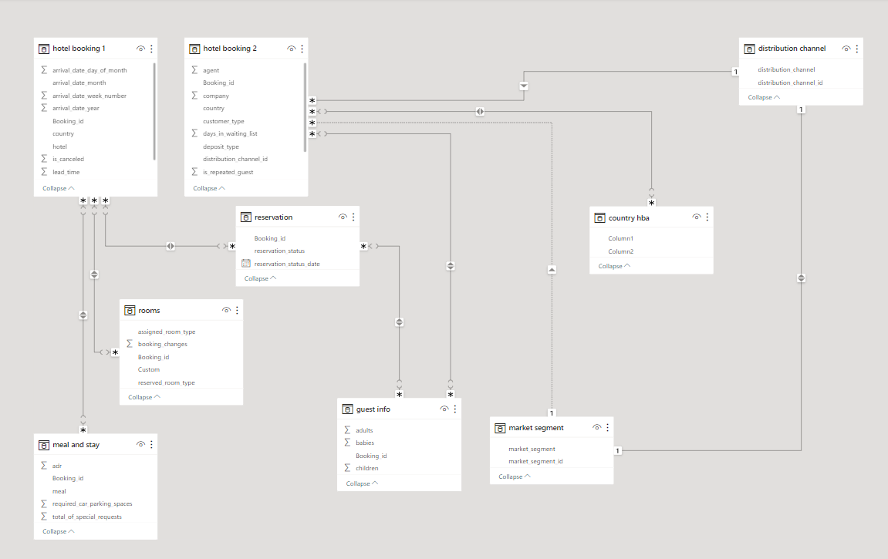
ER DIAGRAM

Slide 5

POWER BI PROBLEM STATEMENTS

Slide 6
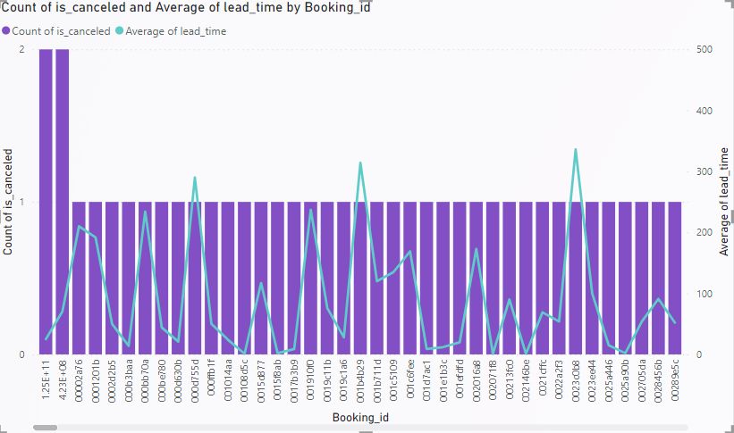
Problem 1
Visualize booking trends over the years, including the number of bookings, cancellations, and average lead time. Identify seasonality patterns.
In this visualization, a clustered column chart displays booking trends over multiple years, showing the number of bookings and cancellations alongside the average lead time. The chart helps identify seasonality patterns by comparing these metrics across different time periods. By analyzing the columns, patterns in booking behavior and cancellation rates can be easily observed, providing valuable insights into the hotel's demand fluctuations over the years.

Slide 7
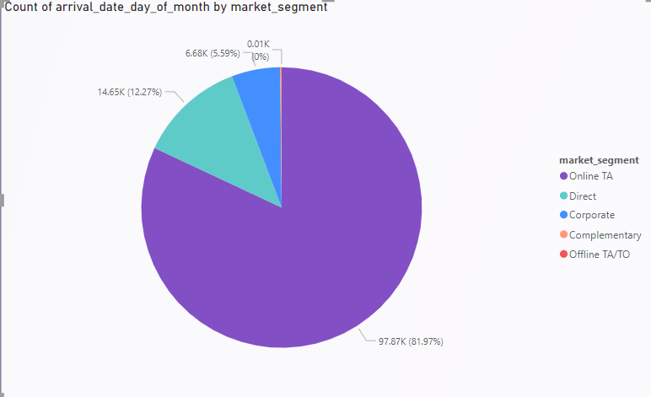
Problem 2
Analyze monthly booking patterns to identify peak months and optimize marketing strategies.
Analyzing monthly booking patterns is crucial to pinpoint peak months and devise effective marketing strategies. The pie chart visually represents the distribution of bookings across the months, highlighting which months experience higher booking volumes. This insight helps optimize marketing efforts, enabling targeted promotions and resource allocation during peak periods, enhancing overall efficiency and revenue potential.

Slide 8
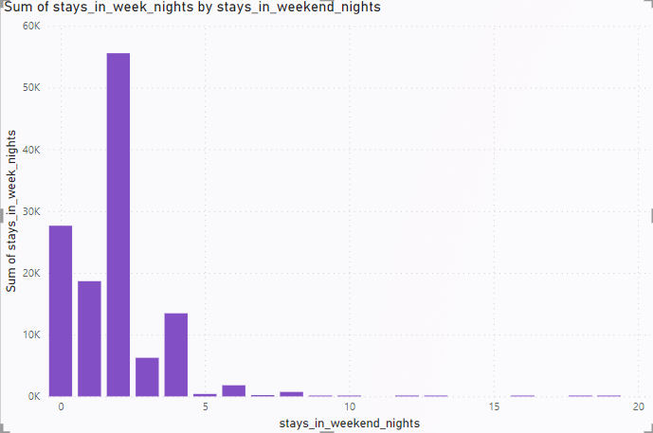
Problem 3
Compare stays in weekend nights and weekday nights to determine preferences and variations by hotel type.
This analysis compares guests' preferences between weekend nights and weekday nights across different hotel types. The line chart visualizes trends over time, showcasing occupancy patterns. The stacked column chart complements this, displaying the breakdown of stays by hotel type and night category. Insights from this analysis reveal if guests prefer specific hotel types during weekends or weekdays, guiding targeted marketing and service strategies for different days of the week.

Slide 9
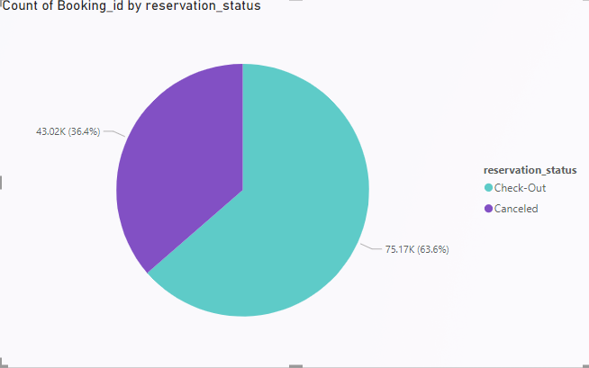
Problem 4
Calculate and visualize the booking conversion rate (canceled bookings to total bookings) over time.
The booking conversion rate, calculated as the ratio of canceled bookings to total bookings, provides a crucial metric for hotel management. By visualizing this rate over time, often represented using a pie chart, hotels can assess the effectiveness of their booking strategies. A rising conversion rate suggests improved customer satisfaction and effective marketing, while a declining rate might indicate issues needing attention, making it a vital tool for optimizing hotel booking processes and guest experiences.

Slide 10
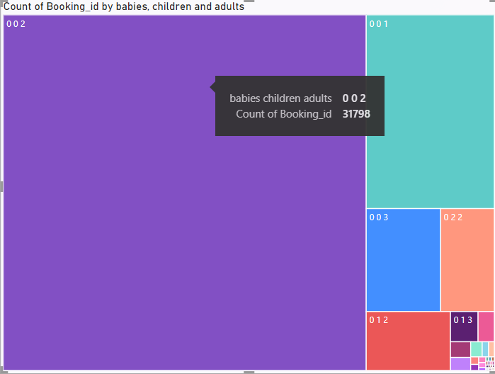
Problem 5
Visualize the distribution of adults, children, and babies in bookings. Explore the impact of children and babies on cancellation rates.
In this analysis, the distribution of adults, children, and babies in bookings is visualized using a treemap chart, providing a clear visual representation of the proportions. Additionally, the impact of children and babies on cancellation rates is explored, revealing insights into how family composition influences booking outcomes. The treemap allows for a quick comparison of the number of bookings with different combinations of adults, children, and babies, highlighting potential correlations between family demographics and cancellation tendencies.

Slide 11
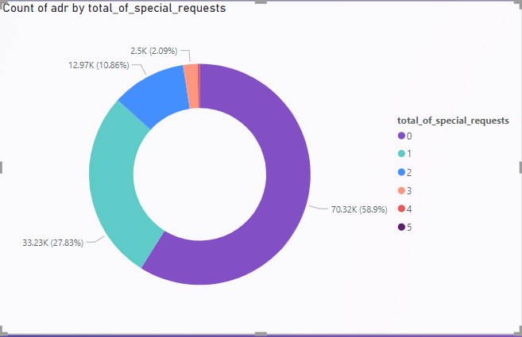
Problem 6
Analyze the distribution of Average Daily Rates (ADR) and identify correlations with the number of special requests made by guests.
In this analysis, we explored the distribution of Average Daily Rates (ADR) and its correlation with the number of special requests made by guests using a donut chart. By visually representing this data, we aimed to understand if there's a relationship between pricing and guest demands. The donut chart efficiently shows the proportion of special requests within different ADR ranges, enabling us to identify patterns and insights into guest behavior and pricing strategies.

Slide 12
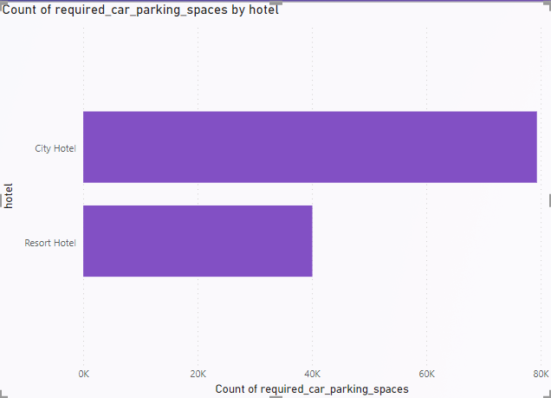
Problem 7
Visualize the relationship between the number of required car parking spaces and booking types (Resort Hotel vs. City Hotel).
The stacked bar chart visually represents the relationship between the number of required car parking spaces and booking types (Resort Hotel vs. City Hotel). Each bar is divided into segments, with each segment representing a specific number of parking spaces required. By comparing the heights of the segments within each bar, you can easily see the parking space distribution for different booking types. This visualization helps identify patterns, preferences, and differences in parking space needs between resort and city hotels, providing valuable insights for strategic decision-making.

Slide 13
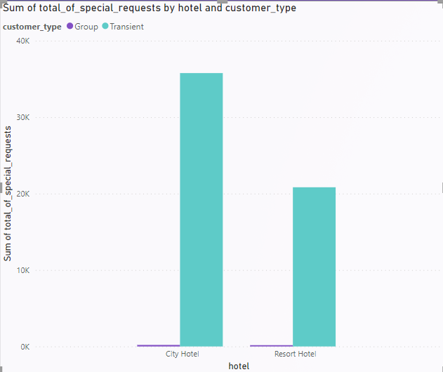
Problem 8
Use Power BI to explore how the total number of special requests made by guests varies by hotel type and customer type (e.g., Transient, Group).
In this Power BI analysis, the clustered column chart visually represents the total number of special requests made by guests, categorized by both hotel type (Resort Hotel vs. City Hotel) and customer type (e.g., Transient, Group). The chart allows a quick comparison of special request volumes across different segments, providing valuable insights into guest preferences and service requirements. The clustered columns intuitively show variations, aiding in understanding patterns and optimizing customer experiences tailored to specific hotel and customer types.

Slide 14
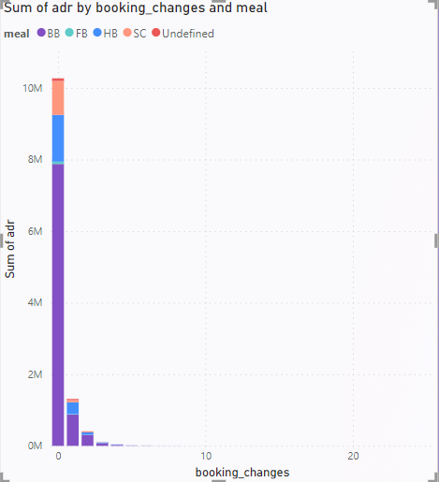
Problem 9
Explore meal plans and their impact on Average Daily Rates (ADR). Analyze meal plan preferences and their association with booking channels.
In this analysis, we delve into the relationship between meal plans and Average Daily Rates (ADR), examining how different meal plans influence pricing. The stacked column chart vividly displays meal plan preferences across various booking channels. By visually contrasting ADR variations among different meal plans, we gain insights into guest preferences, enabling strategic pricing decisions and tailored marketing strategies for each booking channel.

Slide 15
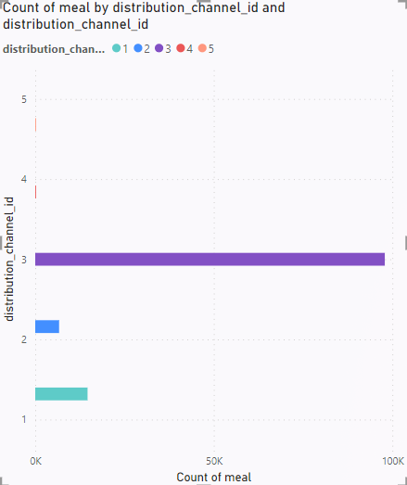
Problem 10
Analyze how meal plans correlate with stay duration and investigate any differences in stay lengths based on meal plans.
In this analysis, we explored the correlation between meal plans and stay duration using a clustered bar chart. By comparing different meal plans, we investigated any variations in guests' lengths of stay. The chart visually represents how guests with different meal plans differ in their stay durations, providing valuable insights into the relationship between meal offerings and the length of guests' stays.

Slide 16
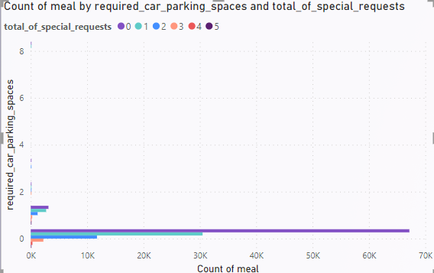
Problem 11
Correlate parking requirements and special requests with different meal plans. Determine if certain meal plans result in more requests or parking needs.
The clustered bar chart visually represents the correlation between meal plans, parking requirements, and special requests. By grouping data into distinct bars for each meal plan, it provides a clear comparison of special requests and parking needs associated with different dining options. Analyzing the chart helps identify patterns, such as whether specific meal plans lead to higher demands for parking spaces or specific guest requests, enabling strategic adjustments in hotel services and facilities based on guest dining preferences.

Slide 17
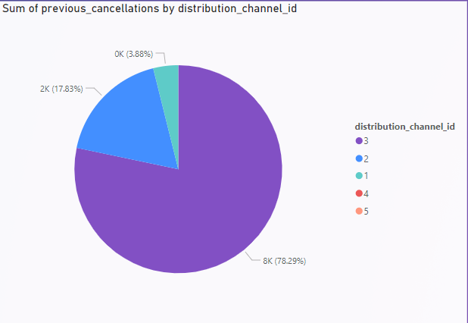
Problem 12
Explore how meal plans are distributed across various booking channels. Analyze if certain channels are associated with specific meal plans.
This analysis examines the distribution of meal plans across different booking channels. By utilizing a pie chart, it visually illustrates the proportion of meal plans attributed to each booking channel. Through this visualization, we can identify patterns and determine if particular booking channels are linked to specific meal plans, providing valuable insights for targeted marketing and service customization strategies in the hospitality industry.

Slide 18
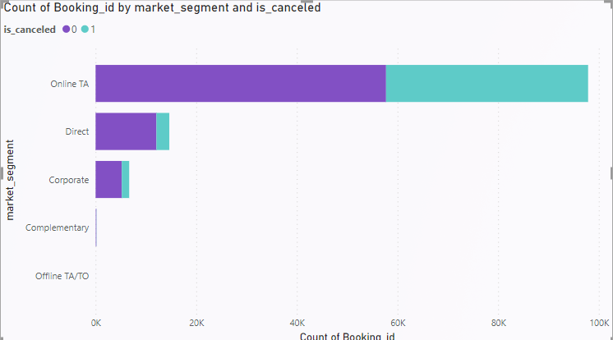
Problem 13
Visualize booking distribution across different market segments and analyze cancellation rates within each segment.
This visualization illustrates the distribution of bookings across various market segments using a stacked bar chart. Each segment is represented as a different color within the bars. By analyzing cancellation rates within each segment, we gain insights into which market segments have higher or lower rates of cancellations, allowing us to identify trends and make data-driven decisions to improve booking strategies and guest satisfaction.

Slide 19
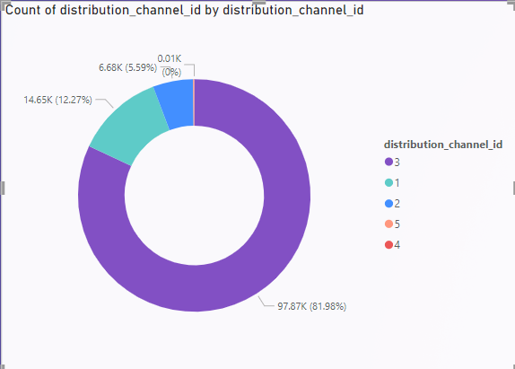
Problem 14
Compare the effectiveness of booking distribution channels in generating confirmed bookings. Identify the most commonly used channels by guests.
In this analysis, the effectiveness of various booking distribution channels in generating confirmed bookings is evaluated using a donut chart. The chart visually compares the contribution of different booking channels, revealing which channels result in successful bookings. Additionally, the chart highlights the most commonly used channels by guests, providing insights into preferred platforms for making reservations. This analysis aids in optimizing marketing strategies, focusing on the most effective channels, and enhancing the overall booking experience based on guest preferences.

Slide 20
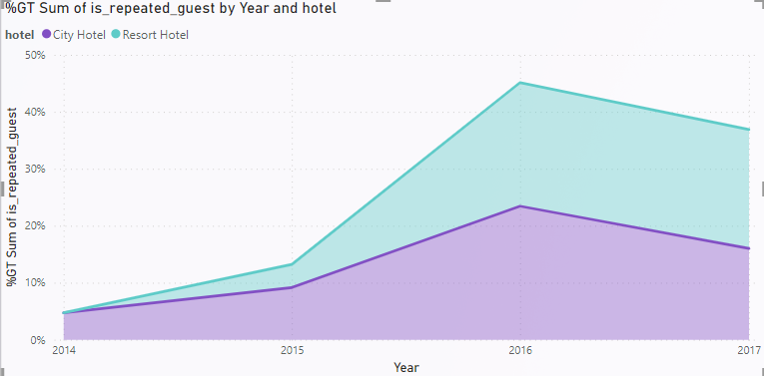
Problem 15
Visualize the percentage of repeated guests for each hotel type (Resort Hotel vs. City Hotel) over time. Explore factors influencing guest retention.
In this analysis, a stacked area chart is used to visualize the percentage of repeated guests over time for Resort Hotels and City Hotels. The chart displays the trends of guest retention, highlighting the relative proportions of new and returning guests. By exploring these patterns, we gain insights into the effectiveness of guest retention strategies for each hotel type, helping identify factors influencing guest loyalty and enhancing customer experience.

Slide 21
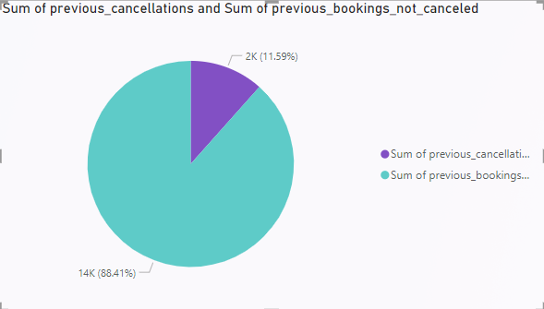
Problem 16
Analyze the impact of a guest's booking history (previous cancellations and non canceled bookings) on their likelihood of canceling a current booking.
This analysis explores how a guest's booking history, specifically examining previous cancellations and successful bookings, influences the likelihood of canceling a current reservation. The pie chart visually represents this impact, highlighting the proportions of guests who canceled based on their past booking behavior. Understanding these patterns helps in anticipating potential cancellations and tailoring customer interactions to minimize booking attrition.

Slide 22
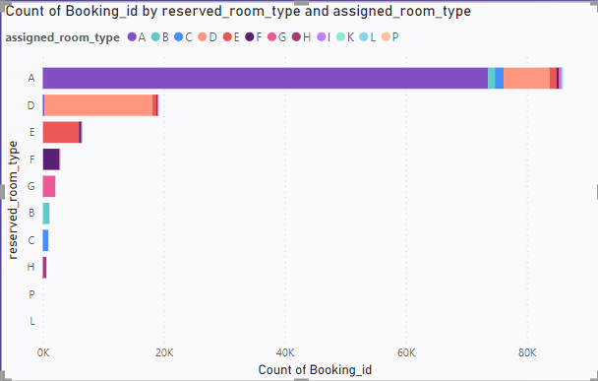
Problem 17
Visualize the distribution of reserved and assigned room types. Analyze whether guests tend to receive the room type they initially reserved.
The visualization presents the distribution of reserved and assigned room types using a stacked bar chart. It helps analyze whether guests receive the room type they initially reserved. Each bar represents a booking, stacked to show the reserved room type in one color and the assigned room type in another. By comparing these segments, it becomes clear if guests often receive their preferred room type or if there are common deviations, providing valuable insights into customer satisfaction and operational efficiency.

Slide 23
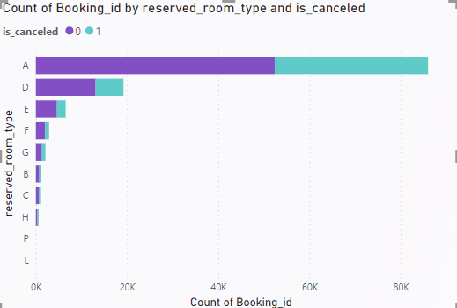
Problem 18
Investigate the relationship between the number of booking changes made by guests and their likelihood of canceling a booking.
The investigation explores the correlation between guest-initiated booking changes and booking cancellations. The stacked bar chart visually represents this relationship: each bar segment represents a booking change category (e.g., canceled or not canceled), with the height indicating the total bookings. By analyzing the chart, one can discern patterns, understanding how alterations made by guests influence their likelihood of canceling reservations, crucial insights for managing booking modifications effectively.

Slide 24
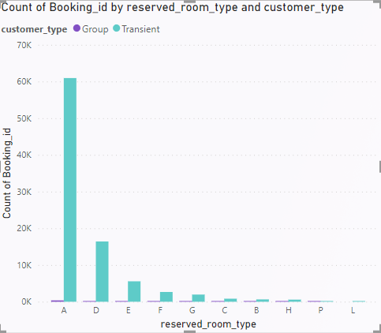
Problem 19
Analyze room type preferences based on customer types (e.g., Transient, Group) and identify any patterns in room type selection.
In this analysis, we delve into guests' room preferences based on customer types like Transient and Group. Utilizing a clustered column chart, we visually showcase the distinct patterns of room type selections made by these customer segments. This visualization reveals insights into which room types are preferred by different customer categories, aiding in tailored service offerings and optimizing guest satisfaction.

Slide 25
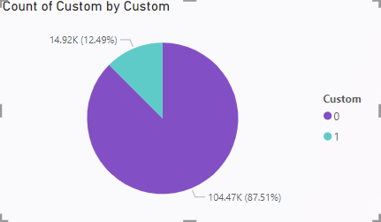
Problem 20
Analyze whether guests who make multiple bookings tend to consistently request the same room type or if their preferences change over time.
This analysis aims to investigate the consistency of room type preferences among guests making multiple bookings. By utilizing a pie chart, the data showcases whether these guests predominantly stick to one room type or if their preferences evolve over time. Understanding these patterns helps hotels tailor their offerings, ensuring a personalized experience for returning guests while adapting to changing preferences.

Slide 26
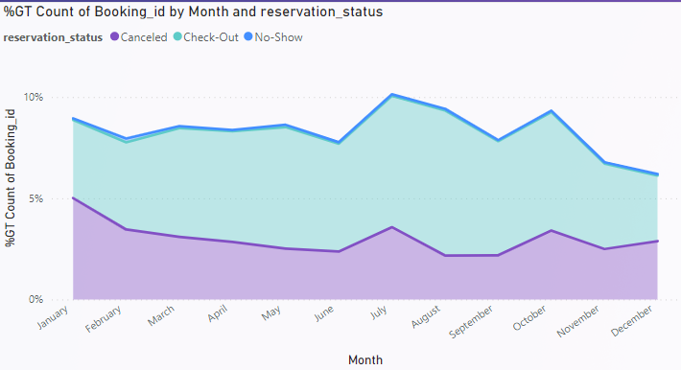
Problem 21
Provide an overview of reservation statuses over time, including the percentage of canceled, checked out, and no show bookings.
The stacked area chart provides a visual overview of reservation statuses over time. It effectively illustrates the historical trend of reservation outcomes, including percentages of canceled, checked-out, and no-show bookings. By observing the changing areas within the chart, you can quickly grasp the evolving patterns of these reservation statuses, aiding in strategic decision-making and operational planning.

Slide 27
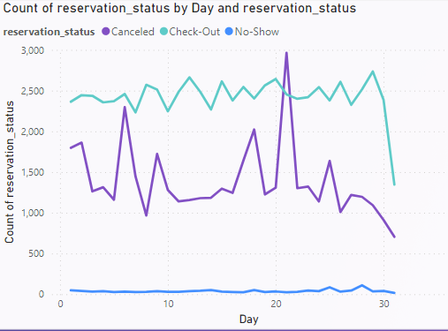
Problem 22
Analyze trends in reservation status dates, such as the busiest checkout dates or patterns in cancellations by month.
Analyzing trends in reservation status dates, such as identifying the busiest checkout dates and patterns in cancellations by month, provides valuable insights into booking behavior. By utilizing a line chart, you can visualize fluctuations over time, pinpointing peak checkout days and spotting cancellation patterns month by month. This analysis helps optimize staffing, promotions, and customer service strategies to enhance guest satisfaction and increase revenue.

Slide 28
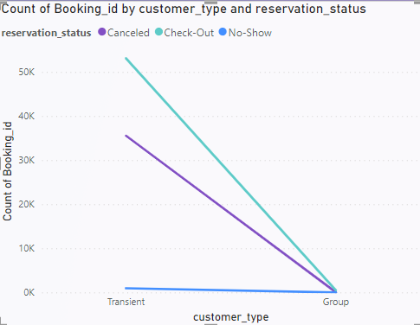
Problem 23
Visualize how reservation statuses vary across different customer types (e.g., Transient, Group) and identify if certain customer types are more likely to result in cancellations or no shows.
The visualization compares reservation statuses among different customer types (e.g., Transient, Group) using a line chart. It helps identify patterns in cancellations and no-shows based on customer segments. By analyzing this data, we can pinpoint which customer types are more likely to cancel or not show up, enabling tailored strategies to improve customer retention and optimize hotel operations.

Slide 29
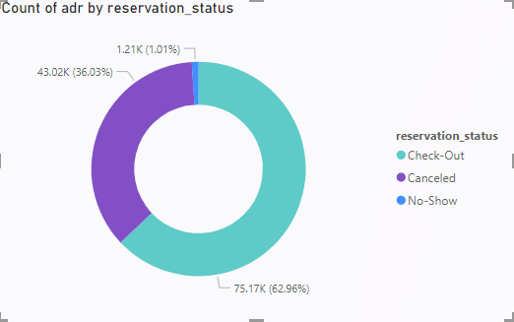
Problem 24
Explore the relationship between reservation statuses and Average Daily Rates (ADR) to determine if there are differences in ADR based on booking outcomes.
In this analysis, we explored the connection between reservation statuses and Average Daily Rates (ADR) using a Donut Chart. By categorizing reservations into statuses like confirmed, canceled, or no-show, we identified differences in ADR based on booking outcomes. The Donut Chart visually represented these variations, offering a clear insight into how reservation outcomes influence the average pricing, enabling strategic decision-making in the hotel industry.

Slide 30
THANK YOU

